Slide 1

COS1512 – Online Class Session – 20 APRIL 2026
COS1512 – INTRODUCTION TO PROGRAMMING II – Using C++
Academic Year: 2026
Date: 20 APRIL 2026
Time: 17:00 PM to 19:00 PM

Slide 2
Chapter 1
Chapter 1

Slide 3
Chapter 1 Introduction to Computers and C++ Programming
Introduction to Computers and C++
A Brief Overview of the History of Computers
Computer Systems
The Language of a Computer
Processing a C++ Program
Problem Solving in Programming
Programming Methodologies
Systems Development Lifecycle Cycle

Slide 4
Introduction to Computers
Introduction to Computers
Outcomes:
Understand a brief History of Computers
Describe the basic components of a computer.
Understand OOP
Understand SDLC
Describe the basic technique for designing and writing a program.
Create the first C++ program and describe how it works.

Slide 5
A Brief Overview of the History of Computers
The first device known to carry out calculations was the abacus. The abacus was invented in Asia but was used in ancient Babylon, China, and throughout Europe until the late middle ages. The abacus uses a system of sliding beads in a rack for addition and subtraction. In 1642, the French philosopher and mathematician Blaise Pascal invented the calculating device called the Pascaline. It had eight movable dials on wheels and could calculate sums up to eight figures long. Both the abacus and Pascaline could perform only addition and subtraction operations. Later in the 17th century, Gottfried von Leibniz invented a device that was able to add, subtract, multiply, and divide. In 1819, Joseph Jacquard, a French weaver, discovered that the weaving instructions for his looms could be stored on cards with holes punched in them.

Slide 6
A Brief Overview of the History of Computers
In the early and mid-1800s, Charles Babbage, an English mathematician and physical scientist, designed two calculating machines: the difference engine and the analytical engine. The difference engine could perform complex operations such as squaring numbers automatically. Babbage built a prototype of the difference engine but did not build the actual device. The first complete difference engine was completed in London in 2002, 153 years after it was designed. It consists of 8,000 parts, weighs five tons, and measures 11 feet long. Ada Augusta, Countess of Lovelace, is considered the first computer programmer.

Slide 7
A Brief Overview of the History of Computers
Early calculation devices
Abacus
Pascaline
Leibniz device
Jacquard’s weaving looms
Babbage machines: difference and analytic engines
Hollerith machine
Early computer-like machines
Mark I
Electronic Numerical Integrator and Calculator (ENIAC)
Von Neumann architecture
Universal Automatic Computer (UNIVAC)
Transistors and microprocessors

Slide 8
Elements of a Computer System
Computer Systems
A set of instructions for a computer to follow is called a program. The collection of programs used by a computer is referred to as the software for that computer.
The actual physical machines that make up a computer installation are referred to as hardware.

Slide 9
Elements of a Computer System…cont.
Hardware
There are three main classes of computers: PCs, workstations, and mainframes.
A PC (personal computer) is a relatively small computer designed to be used by one person at a time. Most home computers are PCs, but PCs are also widely used in business, industry, and science. A workstation is essentially a larger and more powerful PC. You can think of it as an “industrial strength” PC. A mainframe is an even larger computer that typically requires some support staff and generally is shared by more than one user.
A network consists of a number of computers connected so that they may share resources such as printers and may share information. A network might contain a number of workstations and one or more mainframes, as well as shared devices such as printers.

Slide 10
Elements of a Computer System…cont.
Hardware
The computer can be thought of as having five main components:
the input device(s), the output device(s), the processor (also called the CPU, for central processing unit), the main memory, and the secondary memory.
The processor, main memory, and secondary memory are normally housed in a single cabinet. The processor and main memory form the heart of a computer and can be thought of as an integrated unit. Other components connect to the main memory and operate under the direction of the processor.

Slide 11
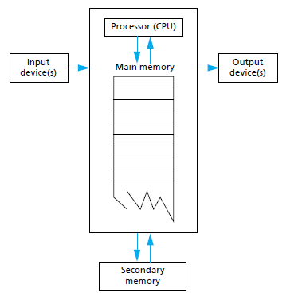
Elements of a Computer System…cont.
Hardware
Main Components of a Computer

Slide 12
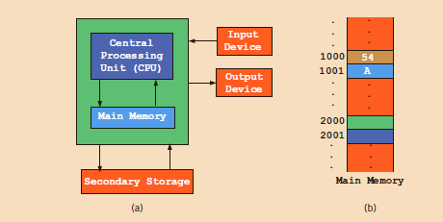
Elements of a Computer System…cont.
Hardware
An input device is any device that allows a person to communicate information to the computer. Your primary input devices are likely to be a keyboard and a mouse.
An output device is anything that allows the computer to communicate information to you. The most common output device is a display screen, referred to as a monitor.
The keyboard and monitor are sometimes thought of as a single unit called a terminal.

Slide 13
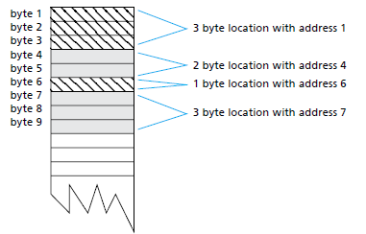
The Language of a Computer
Hardware
Memory Locations and Bytes
A computer has two forms of memory, called main memory and secondary memory. Main memory consists of a long list of numbered locations called memory locations. For example, in one commonly used set of codes, 01000001 is the code for the letter A and also for the number 65. In order to know what the string 01000001 in a particular location stands for, the computer must keep track of which code is currently being used for that location.

Slide 14
The Language of a Computer…cont.
Hardware
Memory Locations and Bytes
Main memory is divided into numbered locations called bytes. The number associated with a byte is called its address. A group of consecutive bytes is used as the location for a data item, such as a number or letter.
The address of the first byte in the group is used as the address of this larger memory location.

Slide 15
The Language of a Computer…cont.
Binary Units
Computers use digital signals.
Because digital signals are processed inside a computer, the language of a computer, called machine language, is a sequence of 0s and 1s. The digit 0 or 1 is called a binary digit, or bit. Sometimes a sequence of 0s and 1s is referred to as a binary code or a binary number.
Bit: A binary digit 0 or 1.

Slide 16
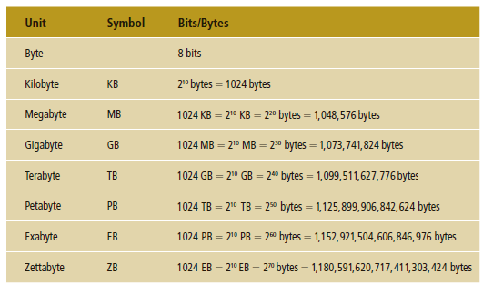
The Language of a Computer…cont.
Binary Units
A sequence of eight bits is called a byte. The number that identifies a byte is called its address. Moreover, 210 bytes 51024 bytes is called a kilobyte (KB). Summary of the terms used to describe various numbers of bytes.

Slide 17
The Language of a Computer…cont.
2. Keyboard and American Standard Code for Information Interchange (ASCII)
Every letter, number, or special symbol (such as * or { ) on your keyboard is encoded 1 as a sequence of bits, each having a unique representation. The most commonly used encoding scheme on personal computers is the seven-bit American Standard Code for Information Interchange (ASCII). The ASCII data set consists of 128 characters numbered 0 through 127.
The number system that we use in our daily life is called the decimal system, or base 10.
Because everything inside a computer is represented as a sequence of 0s and 1s, that is, binary numbers, the number system that a computer uses is called binary, or base 2.

Slide 18
Elements of a Computer System…cont.
Secondary memory
Main memory is often referred to as RAM or random-access memory. It is called random access because the computer can immediately access the data in any memory location. Secondary memory often requires sequential access, which means that the computer must look through all (or at least very many) memory locations until it finds the item it needs.
The processor (also known as the central processing unit, or CPU) is the “brain” of the computer. When a computer is advertised, the computer company tells you what chip it contains. The chip is the processor. The processor follows the instructions in a program and performs the calculations
specified by the program.

Slide 19
Elements of a Computer System…cont.
Software
The operating system allocates the computer’s resources to the different tasks that the computer must accomplish. It is in charge of other programs. If you want to run a program, you tell the operating system the name of the file that contains it, and the operating system runs the program. If you want to edit a file, you tell the operating system the name of the file and it starts up the editor to work on that file. To most users, the operating system is the computer. Most users never see the computer without its operating system. The names of some common operating systems are UNIX, DOS, Linux, Windows, Mac OS, iOS, and Android.

Slide 20
Elements of a Computer System…cont.
Software
A program is a set of instructions for a computer to follow.
The computer follows the instructions in the program and in that way performs some process. The data is what we conceptualize as the input to the program. For example, if the program adds two numbers, then the two numbers are the data. In other words, the data is the input to the program, and both the program and the data are input to the computer (usually via the operating system).

Slide 21
Elements of a Computer System…cont.
High-Level Languages and Low-Level Languages
There are many languages for writing programs. C++ is a high level language, as are most of the other programming languages you are likely to have heard of, such as C, C#, Java, Python, PHP, Pascal, Visual Basic, FORTRAN, COBOL, Lisp, Scheme, and Ada.
High-level languages resemble human languages in many ways. They are designed to be easy for human beings to write programs in and to be easy for human beings to read. A high level language, such as C++, contains instructions that are much more complicated than the simple instructions a computer’s processor (CPU) is capable of following.

Slide 22
Elements of a Computer System…cont.
Low-level languages
The kind of language a computer can understand is called a low-level language. The exact details of low-level languages differ from one kind of computer to another.
Programs written in the form of 0s and 1s are said to be written in machine language, because that is the version of the program that the computer (the machine) actually reads and follows.

Slide 23
Elements of a Computer System…cont.
Low-level languages
Assembly language and machine language are almost the same thing.
The important distinction is that between machine language and high-level languages like C++: Any high-level language program must be translated into machine language before the computer can understand and follow the program.

Slide 24
Compilers
Compilers
A compiler is a program that translates a high-level language program, such as a C++ program, into a machine-language program that the computer can directly understand and execute.
A program that translates a high-level language like C++ to a machine language is called a compiler. A compiler is thus a somewhat peculiar sort of program, in that its input or data is some other program, and its output is yet another program. To avoid confusion, the input program is usually called the source program or source code, and the translated version produced by the compiler is called the object program or object code.

Slide 25
Compilers…cont.
Compilers
These items that are already programmed for you (like input and output routines) are already compiled and have their object code waiting to be combined with your program’s object code to produce a complete machine-language program that can be run on the computer.
Another program, called a linker, combines the object code for these program pieces with the object code that the compiler produced from your C++ program. The interaction of the compiler and the linker are diagrammed… In routine cases, many systems will do this linking for you automatically. Thus, you may not need to worry about linking in many cases.

Slide 26
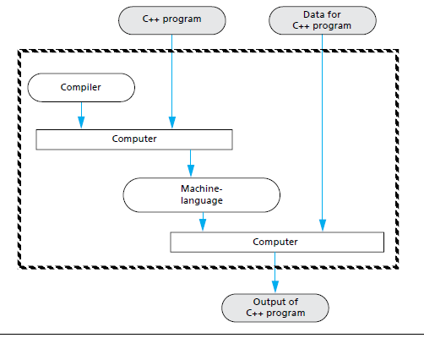
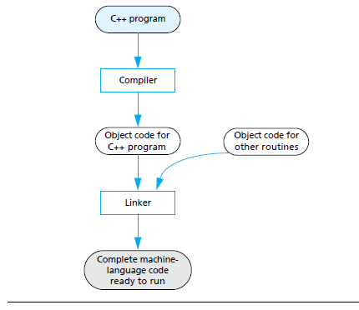
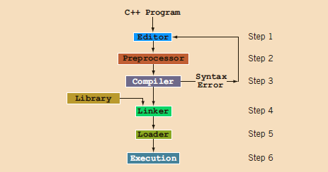
Compilers…cont.
Compilers
Compiling and Running a C++ Program (Basic Outline)
Preparing a C++ Program for Running

Slide 27
Processing a C++ Program
Programming is a process of problem solving.
To be a good problem solver and a good programmer, you must follow good problem solving techniques. One common problem-solving technique includes analyzing a problem, outlining the problem requirements, and designing steps, called an algorithm, to solve the problem.
Algorithm: A step-by-step problem-solving process in which a solution is arrived at in a finite amount of time.
In a programming environment, the problem-solving process requires the following three steps:
1. Analyze and outline the problem and its solution requirements, and
design an algorithm to solve the problem.
2. Implement the algorithm in a programming language, such as C++, and verify that the algorithm works.
3. Maintain the program by using and modifying it if the problem domain changes.

Slide 28
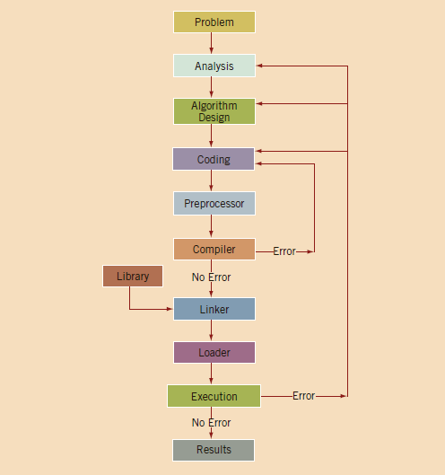
Processing a C++ Program
Programming process with the Problem Analysis–Coding–Execution Cycle

Slide 29
Compiling and Running a C++ Program
Compiling and Running a C++ Program (Basic Outline)
Statements that begin with the symbol # are called preprocessor directives. These statements are processed by a program called preprocessor.
The compiler checks the source program for syntax errors and, if no error is found, translates the program into the equivalent machine language. The equivalent machine language program is called an object program.
Object program: The machine language version of the high-level language program. A program called a compiler translates instructions written in high-level languages into machine code.
Compiler: A program that translates instructions written in a high-level language into the equivalent machine language.
The prewritten code (program) resides in a place called the library. A program called a linker combines the object program with the programs from libraries.
Linker: A program that combines the object program with other programs in the library and is used in the program to create the executable code.
You must next load the executable program into main memory for execution. A program called a loader accomplishes this task.
Loader: A program that loads an executable program into main memory. The final step is to execute the program.

Slide 30
Programming and Problem Solving
Principles to design and write programs by implementing algorithms and program design.
An Algorithm
A sequence of precise instructions which leads to a solution is called an algorithm.
Example:
Design an algorithm to find the perimeter and area of a rectangle. The perimeter and area of the rectangle are given by the following formulas:
perimeter = 2 * (length + width)
area = length * width
An Example of an Algorithm.
Get the length of the rectangle
Get the width of the rectangle
Find the perimeter with this equation:
perimeter = 2 * (length + width)
Find the area with this equation:
area = length * width

Slide 31
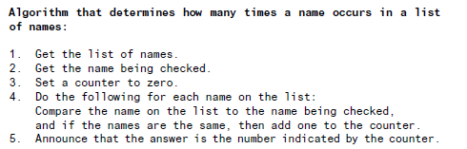
Programming and Problem Solving
Another Example of an Algorithm.

Slide 32
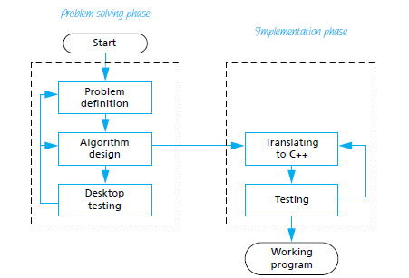
Programming and Problem Solving
Program Design
Designing a program is often a difficult task. There is no complete set of rules, no algorithm to tell you how to write programs. Program design is a creative process. Still, there is the outline of a plan to follow (Program Design Process).
Program Design Process

Slide 33
Programming Methodologies
Two popular approaches to programming design
Structured design
Object-oriented design

Slide 34
Programming Methodologies...cont.
Structured:
Structured procedural programming: the program moves through a linear series of instructions.
Structured design
Involves dividing a problem into smaller subproblems
Structured programming
Involves implementing a structured design
The structured design approach is also called:
Top-down (or bottom-up) design
Stepwise refinement
Modular programming

Slide 35
Programming Methodologies...cont.
Structured:
Structured procedural programming: the program moves through a linear series of instructions.
Structured design
Involves dividing a problem into smaller subproblems
During the design stage, the processing steps are described in an algorithm.
An algorithm is a sequence of precise instructions that leads to a solution.
Structured programming
Involves implementing a structured design
The structured design approach is also called:
Top-down (or bottom-up) design
Stepwise refinement
Modular programming

Slide 36
Programming Methodologies…cont.
Object-oriented:
Object-oriented programming: the data states (attributes) and functionality to modify (functions) those data states are packaged together while keeping the implementation details hidden.
Object-oriented design (OOD)
Identify components called objects
Determine how objects interact with each other
Specify relevant data and possible operations to be performed on that data
Each object consists of data and operations on that data

Slide 37
Programming Methodologies…cont.
Object-oriented programming
An object combines data and operations on the data into a single unit (called a class).
A programming language that implements OOD is called an object-oriented programming (OOP) language.
To design and use objects, you must learn how to:
Represent data in computer memory
Manipulate data
Implement operations

Slide 38
Programming Methodologies…cont.
In object–oriented programming:
Applications are organized around objects rather than processes.
A system is seen as a collection of interacting objects.
Program components are envisioned as objects that belong to classes and are similar to real-world objects.
The programmer manipulates the objects and has them interrelate to achieve a desired result. The focus is on determining the objects you want to manipulate rather than the processes or logic required to manipulate the data. [UML Class Diagram]
Object-oriented programming involves three fundamental concepts: encapsulation, inheritance and polymorphism.

Slide 39
Programming Methodologies…cont.
Writing object-oriented programs involves:
Creating classes, write algorithms, and implement them
Creating objects from those classes, and
Creating applications, i.e. stand-alone executable programs, that use those objects.
C++ was designed to implement OOD.
OOD is used with structured design.
Code with OOP design is:
Flexible
Modular
Abstract
If classes are designed properly, they can be reused repeatedly to develop new programs.

Slide 40
Programming Methodologies…cont.
What is an Object?
An object is an instance of a class. An object generally represents a concrete entity in the real world such as a person, place or thing.
Such an object has certain characteristics or attributes and certain behaviours or actions.
An object’s characteristics represent data or facts that we know about the object i.e. the state of the object.
The object’s behaviours are actions that the object can take. These actions are expressed in functions or methods that execute algorithms.
The object interacts with other objects through messages or function calls.
objects.

Slide 41
Programming Methodologies…cont.
What is a Class?
A class is a template or blueprint that can be used to construct or instantiate many similar objects. A class can also be seen as a sort of user-defined data type, which we call an abstract data type (ADT).
A class hides information by restricting access to it. In effect the data and methods within an object are hidden from users to prevent inadvertent changes. Users of the class simply need to understand how to use the interface or interaction between the object and its methods.
Encapsulation: combining the attributes and behaviours, i.e. an object’s data and functions together to form a class.

Slide 42
Programming Methodologies…cont.
There are four major benefits to object-oriented programming:
Encapsulation: in OOP, you bundle code into a single unit where you can determine the scope of each piece of data.
Abstraction: by using classes, you generalize your object types, simplifying your program.
Inheritance: because a class can inherit attributes and behaviours from another class, you can reuse more code.
Polymorphism: one class can be used to create many objects, all from the same flexible piece of code.

Slide 43
Software Development Lifecycle
The Software Life Cycle (pg. 49)
The System Design Life Cycle (SDLC) is a structured process used to plan, design, develop, test, deploy, and maintain software systems. It helps teams build reliable, scalable, and high-quality systems by following well-defined phases, ensuring that business requirements are correctly translated into technical solutions.
Designers and Development Team of large software systems, such as compilers and operating systems, and other applications divide the software development process into six phases collectively known as the software life cycle.

Slide 44
Software Development Lifecycle
The Software Life Cycle (pg. 50)
The six phases of this life cycle are:
1. Analysis and specification of the task (problem definition or requirements gathering)
2. Design of the software (object and algorithm design) [UML diagrams and algorithms]
3. Implementation (development / coding)
4. Testing
5. Deployment
6. Maintenance and evolution of the system
7. Obsolescence
Refer to the below URLs to better understand the role of each phase:
https://www.geeksforgeeks.org/system-design/system-design-life-cycle-phases-models-and-use-cases/
https://aws.amazon.com/what-is/sdlc/

Slide 45
Writing a C++ Program
This is a practical work, we will continue with it during the next class session.
See prescribed book from pg. 50.
Intro.
Origins of C++.
Sample C++ Program with different components of a C++ program
Program errors
Testing and debugging.

Slide 46
Useful Resources on OOP
Useful Resources
Prescribed Book:
Savitch, W., & Mock, K. (2018). Problem solving with C++ (10th ed.). Pearson.
Recommended Book:
Malik, D. S. (2018). C++ programming: Program design including data structures (8th ed.). Cengage Learning.
Web Resources:
https://www.codecademy.com/articles/cpp-object-oriented-programming

